Slide 1
Artificial Intelligence
Dr.K.Rajakumar
SCOPE

Slide 2
Artificial
  Produced by human art or effort, rather than originating naturally.
Intelligence
is the ability to acquire knowledge and use it" [Pigford and Baur]
So AI was defined as:
  AI is the study of ideas that enable computers to be intelligent.
  AI is the part of computer science concerned with design of computer systems that exhibit human intelligence(From the Concise Oxford Dictionary)

Slide 3
* Eight definitions of AI, laid out along two dimensions
Thought process and reasoning
Success In terms of fidelity
Thinking Humanly Thinking Rationally (Haugeland,1985) (Charniak and (Bellman,1978) McDermott,1985) (Winston,1992)
Acting Humanly Acting RationaLly (Kurzweil,1990) Poole et al., 1998) (Rich and Knight,1991) (Nilson,1998)
Ideal performance measure(rationality)
Behaviour

Slide 4
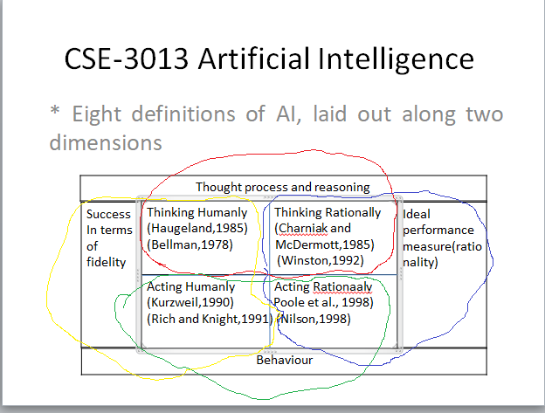

Slide 5
Acting Humanly
The Turing test proposed by Alan Turing (1950)
Turing test was designed to provide a satisfactory operational definition of intelligence
A computer passes the test if a human interrogator, after posing some written questions, cannot tell whether the written responses come from a person or from a computer

Slide 6

Systems that act like humans
?
You enter a room which has a computer terminal. You have a fixed period of time to type what you want into the terminal, and study the replies. At the other end of the line is either a human being or a computer system.
If it is a computer system, and at the end of the period you cannot reliably determine whether it is a system or a human, then the system is deemed to be intelligent.

Slide 7
For now, the computer would need to possess the following capabilities:
Natural Language Processing(to enable it communicate in English or some other languages)
Knowledge representation (to store what it knows or hears)
Automated Reasoning (to use the stored information to answer questions and to draw new conclusions)

Slide 8
Machine Learning(to adapt to new circumstances and to detect and extrapolate patterns)
Computer Vision(to perceive objects)
Robotics(to manipulate objects and move about)

Slide 9
Thinking Humanly
The Cognitive model approach
If we are going to say that a given program thinks like a human, we must have some way determining how humans think.
Through introspection-trying to catch our own thoughts.
Through psychological experiments-observing a person in action.
Through brain imaging- observing the brain in action.

Slide 10
If the programmers input-output behaviour matches corresponding human behaviour ,that is evidence that some of the program’s mechanisms could also be operating in humans.
for eg. Allen Newell and Herbert Simon, who developed GPS, the General Problem Solver in 1961.

Slide 11
Thinking rationally
Humans are not always ‘rational’
Rational - defined in terms of logic?
Logic can’t express everything (e.g. uncertainty)
Logical approach is often not feasible in terms of computation time (needs ‘guidance’)
“The study of mental facilities through the use of computational models” (Charniak and McDermott)
“The study of the computations that make it possible to perceive, reason, and act” (Winston)

Slide 12
The “laws of thought approach”
There are two main obstacles to this approach
It is not easy to take informal knowledge and state it in the formal terms required by logical notation, particularly when the knowledge is 100% certain
There is a big difference between solving a problem “in principle” and solving it in practice

Slide 13
Acting rationally
Rational behavior: doing the right thing
The right thing: that which is expected to maximize goal achievement, given the available information
Giving answers to questions is ‘acting’.
I don't care whether a system:
  replicates human thought processes
  makes the same decisions as humans
  uses purely logical reasoning

Slide 14
Study AI as rational agent –
2 advantages:
  It is more general than using logic only
    Because: LOGIC + Domain knowledge
  It allows extension of the approach with more scientific methodologies

Slide 15
The rational agent approach
An agent is just something that acts(agent comes from Latin agere, to do)
All computer programs do something, but computer agents are expected to do more.
Operate autonomously, perceive their environment ,persist over a prolonged time period, adapt to change and create and perceive goals

Slide 16
A rational agent is one that acts so as to achieve the best outcome or , when there is uncertainty, the best expected outcome

Slide 17
The foundations of AI
1.Philosophy
Can formal rules be used to draw valid conclusions?
How does the mind arise from a physical brain?
Where does a knowledge come from?
How does a knowledge lead to action?

Slide 18
2.Mathematics
What are the formal rules to draw valid conclusions?
What can be computed?
How do we reason with uncertain information?
Philosophers staked out some of the fundamental ideas of AI, but the leap to formal science required a level of mathematical formalization in 3 fundamental areas: logic, computation and probability

Slide 19
3. Economics
How should we make decisions so as to maximize payoff?
How should we do this when others may not go long?
How should we do this when the payoff may be far in the future?

Slide 20
4.Neuroscience
How do brain process information?
The parts of a nerve cell or neuron. Each neuron consists of a cell body or soma, that contains a cell nucleus.
Branching out from the cell body are a number of fibers called dendrites and a single long fiber called the axon.
Typically, an axon is 1 cm long (100 times the diameter of the cell body), but can reach up to 1 meter.
A neuron makes connections with 10 to 100,000 other neurons at junctions called synapses.
Signals are propagated from neuron to neuron by a complicated electrochemical reaction.

Slide 21
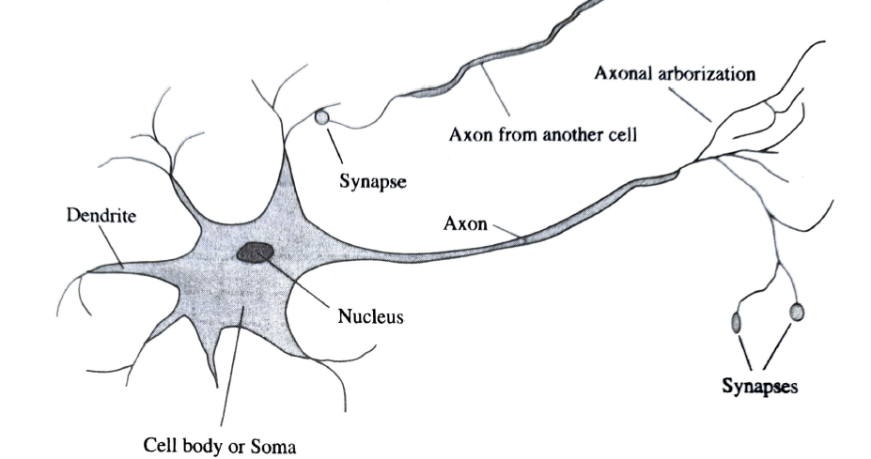

Slide 22
5.Psychology
How do humans and animals think and act?
Cognitive psychology

Slide 23
6.Computer Engineering
How can we build an efficient computer?
7.Control theory and cybernetics
How can artefacts operate under their own control?
8.Linguistics
How does language relate to thought?

Slide 24
Applications
1.Robotics Vehicles:
A driverless robotic car named STANLEY sped through the rough terrain of the Mojave desert at 22mph, finishing the 132 mile course first to win DARPA Grand Challenge.
2.Speech Recognition:
A traveller call a United Airlines to book a flight can have the entire conversation guided by an automated speech recognition and dialog management system

Slide 25
3.Autonomus planning and schedule:
A hundred million miles from Earth, NASA’s remote agent program become the first on-board autonomous planning program to control the scheduling of operations for a spacecraft.
REMOTE AGENT generated plans from high-level
Goals specified from ground and monitored the execution of those plans- detecting, diagnosing and recovering from problems as they occurred.

Slide 26
3.Game playing:
IBM’s DEEP BLUE became the first computer program to defeat the world champion in a chess match when it bested Garry Kasparov
4.Spam fighting:
Each da, learning algorithms classify over a billion messages as spam, saving the recipient from having to waste time to delete.
Learning algorithms work best.

Slide 27
5.Logistic planning:
DART(Dynamic Analysis Replanning Tool) to do automated logistics planning and scheduling for transportation
6.Robotics:
The iRobot Corporation has sold over 2 million Roomba robotic vacuum cleaners for home use.
7.Machine Translation:
A computer program automatically translates from Arabic to English
The program uses a statistical model built from examples of English text two trillion words

Slide 28
Agents and Environments
An agent is anything that can be viewed as perceiving its environment through sensors and acting upon that environment through actuators.
A Human Agent:
Sensors: Ears, nose, eyes and other sensors
Actuators: Hands, legs, vocal tract and so on
A Robotic Agent:
Sensors: Cameras and infrared range finders
Actuators: Motors

Slide 29
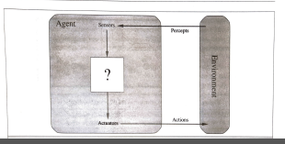
A software Agent:
Sensors: Keystrokes, file contents and network packets
Actuators: Displaying on the screen, writing files and sending network packets.

Slide 30
Rational Agent
What is rational at any given time depends on four things
The performance measure.
The agent’s prior knowledge of the environment.
The actions that the agent can perform
The agent’s percept sequence to date.
This leads to a definition of a rational agent
For each possible percept sequence, a rational agent should select an action that is expected to maximize its performance measure, given the evidence provided by the percept sequence and whatever built-in knowledge the agent has

Slide 31
Eg: Simple vacuum-cleaner agent that cleans a square if it is dirty and moves to the other square.
Performance measure depends on environment, sensors and actuators the agent has.
Irrational: once all the dirt is cleaned up, the agent will oscillate needlessly back and forth.
Rational: for this case would do nothing once it is sure that all the squares are clean. If clean squares can become dirty again, the agent should occasionally check re-clean them if needed.

Slide 32
Omniscience, learning and autonomy
An omniscient agent knows the actual outcome of its action and can act accordingly, but omniscience is impossible in reality
Information gathering
Information gathering provided by the exploration
Learning
A rational agent should be autonomous-it should learn what it can to compensate for partial or incorrect prior knowledge

Slide 33
AI Environment
Task environment:
Performance,Environment, Actuators, Sensors
PEAS(Performance,Environment, Actuators, Sensors)

Slide 34
1-Complete vs. Incomplete
Complete AI environments are those on which, at any give time, we have enough information to complete a branch of the problem. Chess is a classic example of a complete AI environment. Poker, on the other hand, is an incomplete environments as AI strategies can’t anticipate many moves in advance and, instead, they focus on finding a good ‘equilibrium” at any given time.

Slide 35
2-Fully Observable vs. Partially Observable
A fully observable AI environment has access to all required information to complete target task. Image recognition operates in fully observable domains. Partially observable environments such as the ones encountered in self-driving vehicle scenarios environments such as the ones encountered in self-driving vehicle scenarios deal with partial information in order to solve AI problems.

Slide 36
3-Competitive vs. Collaborative
Competitive AI environments face AI agents against each other in order to optimize a specific outcome. Games such as GO or Chess are examples of competitive AI environments. Collaborative AI environments rely on the cooperation between multiple AI agents. Self-driving vehicles or cooperating to avoid collisions or smart home sensors interactions are examples of collaborative AI environments.

Slide 37
4-Static vs. Dynamic
Static AI environments rely on data-knowledge sources that don’t change frequently over time. Speech analysis is a problem that operates on static AI environments. Contrasting with that model, dynamic AI environments such as the vision AI systems in drones deal with data sources that change quite frequently.

Slide 38
5-Discrete vs. Continuous
Discrete AI environments are those on which a finite [although arbitrarily large] set of possibilities can drive the final outcome of the task. Chess is also classified as a discrete AI problem. Continuous AI environments rely on unknown and rapidly changing data sources. Vision systems in drones or self-driving cars operate on continuous AI environments.

Slide 39
6-Deterministic vs. Stochastic
Deterministic AI environments are those on which the outcome can be determined based on a specific state. In other words, deterministic environments ignore uncertainty. Most real world AI environments are not deterministic. Instead, they can be classified as stochastic. Self-driving vehicles are a classic example of stochastic AI processes.

Slide 40
7.Episodic vs. sequential
Episodic:
Agent experience is divided into atomic episodes. In each episode the receives a percept and then performs a single action.
The next episode does not depend on the actions taken in previous episodes
Eg: Image Analysis, Part- picking robot

Slide 41
Sequential:
The current decision could affect all future decisions.
Eg: Chess and Taxi driving are sequential
Episodic environments are much simpler than sequential environment because the agent does not need to think ahead.

Slide 42
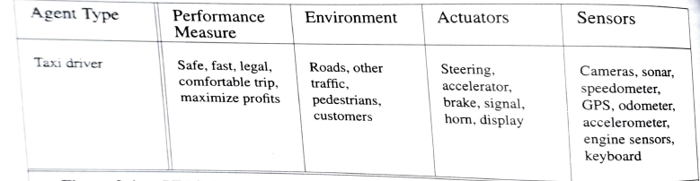

Slide 43
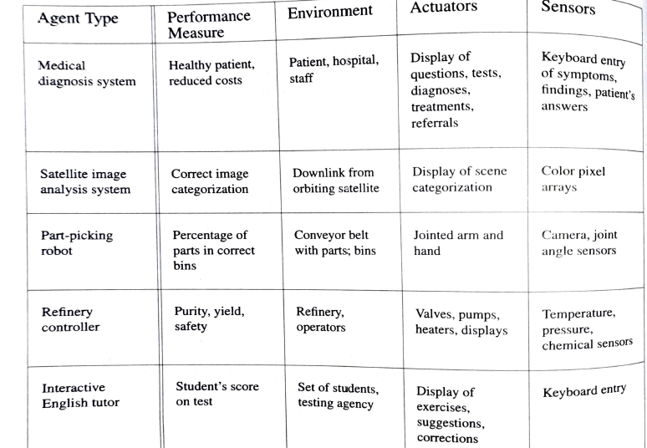

Slide 44
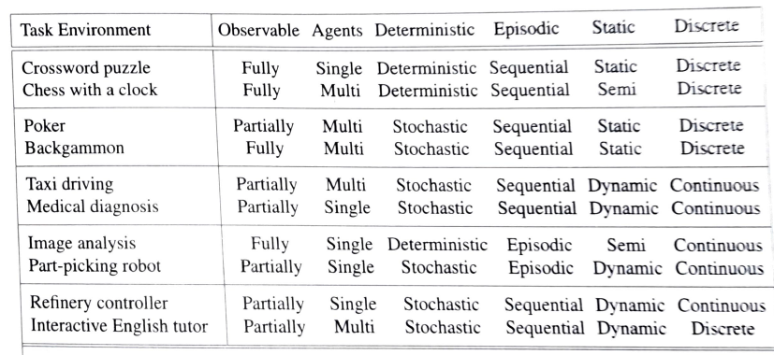
Task environment and their characteristics

Slide 45
The structure of Agents
The job of AI is to design an agent program to implements the agent function-the mapping from precept's to actions.
Architecture : Program will run on some sort of computing device with physical sensors and actuators .
Agent = architecture+program
Eg: Program recommended action is Speech then what is architecture ?

Slide 46
Agent programs
Agent program: Which takes the current percept as input
Agent function: Which takes the entire percept history
Trivial agent program: It keeps the track of the percept sequence and then uses it to index into a table of actions to decide what to do.

Slide 47
TABLE-DRIVEN-AGENT
function TABLE-DRIVEN-AGENT(percept)returns as action
persistent: percepts, a sequence,initially empty
table, a table of actions,indexed by percept
sequences,initially fully specified
append percept to the end of percepts
action LOOKUP(percepts,table)
return action

Slide 48
It is instructive to consider why the table-driven approach to agent construction is doomed to failure.

Slide 49
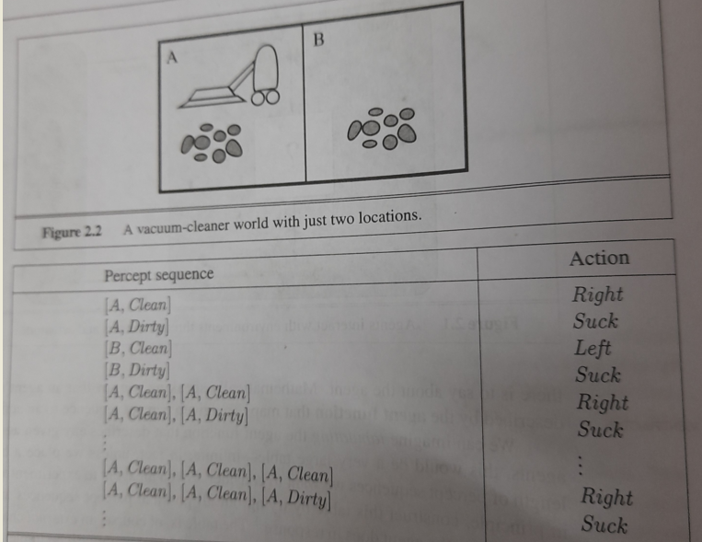

Slide 50
Percept sequence | Action
[A, Clean] [A, Dirty] [B, Clean] [B, Dirty] | Right Suck Left Suck
Percept sequence | Action
[A, Clean],[A, Clean] [A, Clean],[A, Dirty] [A, Clean],[B, Clean] [A, Clean],[B, Dirty] [A, Dirty],[A, Clean] [A, Dirty],[A, Dirty] [A, Dirty],[B, Clean] [A, Dirty],[B, Dirty] [B, Clean] [B, Dirty] | Right Suck Left Suck Right Suck Left Suck
Notes:
Possible sequence=4 for time period t=1; Possible sequence=4+4+4+4=16 for time period t=2; if t=N, possible sequence =?

Slide 51
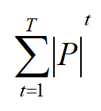
In this vacuum cleaner table-driven approach when the time period=1, the possible sequence =4;
If the time period=2, the possible sequence=4+4+4+4=16
Let P be the set of possible percepts and let T be the life time of the agent(the total number of percepts it will receive)
The lookup table will contain
It is instructive to consider why the table-driven approach to agent construction is doomed to failure.

Slide 52


Table-Driven Agent drawbacks
Eg: Automated Taxi, the visual input from camera comes in at the rate of roughly 27Mbps(30 frames per second,640x480 pixels with 24 bits of colour information)
Look up table with over for entries for an hours driving.
Look up table for chess would have at least

Slide 53
Types of Agents
Simple reflex agents
Model-based reflex agents
Goal-based agents
Utility-based agents
Learning agent

Slide 54
1.Simple reflex agents
These agents select actions on the basis of the current percept, ignoring the rest of the percept history.
For vacuum cleaner environment , which cuts down the number of possibilities from to 4.
Further , small reduction comes from the fact that when the current square is dirty, the action does not depend on the location

Slide 55
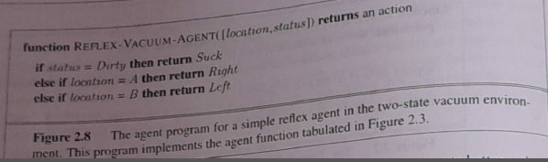

Slide 56
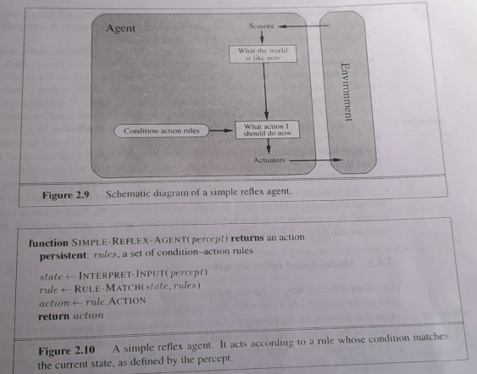
A more general and flexible approach is first to build a general - purpose interpreter for condition action rules and then to create rule sets for specific task environments.

Slide 57
INTERPRET-INPUT function: Generates an abstracted description of the current state from the percept.
RULE-MATCH function: returns the first rule in the set of rules that matches the given description.
Actual implementations can be as simple as a collection of logic gates implementing a Boolean circuit.

Slide 58
Limitations of simple reflex agents
Simple reflex agents are simple, they turn out to be of limited intelligence.
It works, only if the environment is fully observable.
Infinite loops are often unavoidable for simple reflex agents operating in partially observable environments.

Slide 59
2.Model-based reflex agents
The agent should maintain some sort of internal state that depends on the percept history and thereby reflects at least some of the unobserved aspects of the current state.
Knowledge about “how the world works”- whether implemented in simple Boolean circuits or incomplete scientific theories-is called a model of the world. An agent that uses such a model is called a model- based agent.

Slide 60
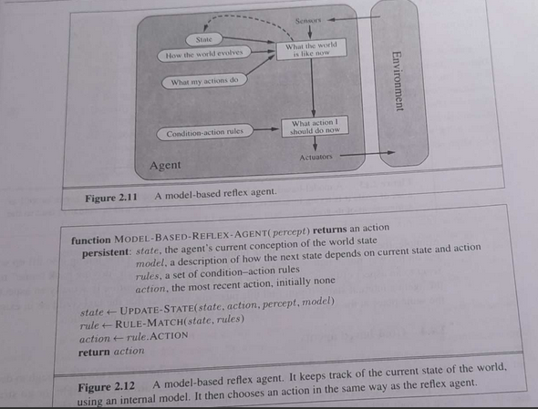
Notes:
Fig: gives the structure of the model-based reflex agent with internal state, showing how the current percept is combined with the old internal state to generate the updated description of the current state, based on the agent’s model of how the world works.

Slide 61
UPDATE-STATE function: Which is responsible for creating the new internal state description.
Regardless of the kind representation used, it is seldom possible for the agent to determine the current state of a partially observable environment exactly(i.e the agent’s best guess or best guesses)

Slide 62
3.Goal-based agents
Knowing something about the current state of the environment is not always enough to decide what to do. In other words, as well as a current state description , the agent needs some sort of goal information that describes the situation that are desirable-for eg,being at the passenger’s destination.
The agent program can combine this with the model(model-based reflex agent) to choose actions that achieve the goal.

Slide 63
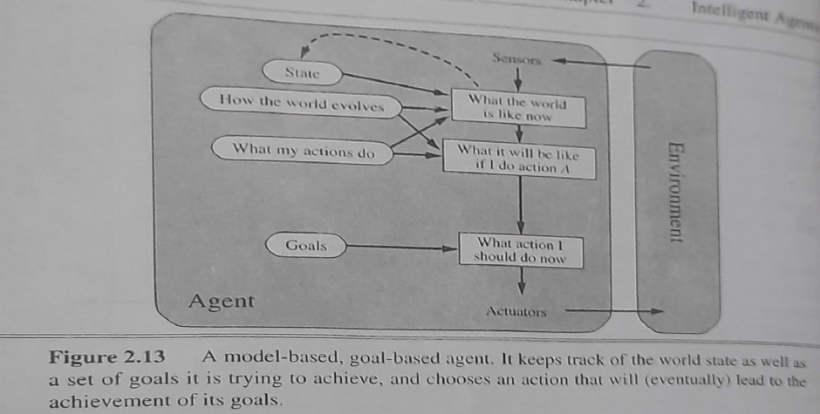

Slide 64
Sometimes goal-based agent is straightforward and sometimes it will be more tricky.
Goal-based agent involves consideration of the future: “What will happen if I do such and such?” and “Will that make me happy”
Eg: Automated Taxi:
Reflex agent -Apply brakes when it sees brake lights
Goal-based agent-It will slow down and given the way the world usually evolves, the only action that will achieve the goal of not hitting others cars is to brake.

Slide 65
Goal-based agent: Less efficient, it is more flexible because the knowledge that support its decisions is represented explicitly and can be modified.
Goal-based agent: Behaviour can easily be changed to go to a destination, simply by specifying that destination as the goal.
The reflex agent’s: Rules for when to turn and when to go straight will work only for a single destination.

Slide 66
4.Utility-based agents
A more general performance measure should allow a comparison of different world states according to exactly how happy they would make the agent.
Here happy means – utility – the quality of being useful.
An agent’s utility function is essentially an internalization of the performance measure. If the internal utility function and the external performance are in agreement, then the agent that chooses actions to maximize its utility will be rational according to the external performance measure.

Slide 67
Partial observability and stochasticity are ubiquitous in the real world, and so, therefore is decision making under uncertainty.
A rational utility-based agent chooses the action that maximizes the expected utility of the action outcomes – that is, the utility the agents expects to deprive, on average, given the probabilities and utilities of each outcome.

Slide 68
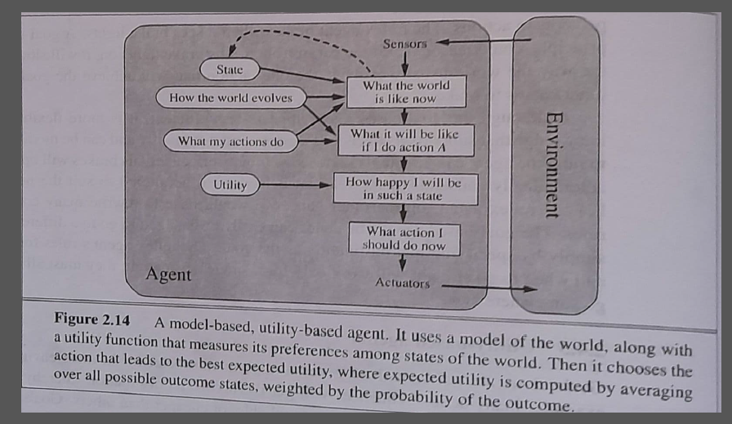

Slide 69
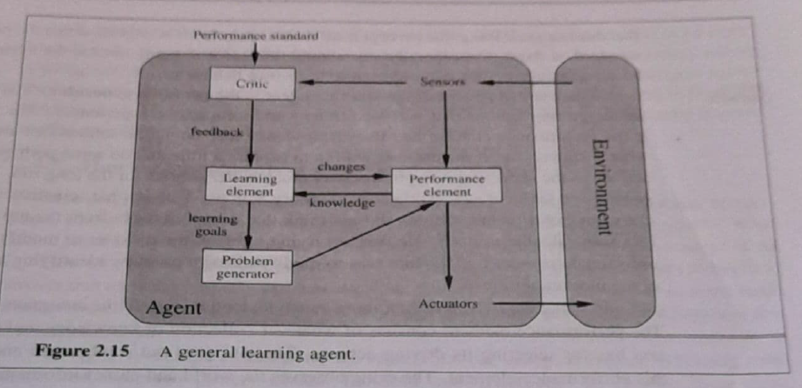
5.Learning Agent

Slide 70
Learning element: Which is responsible for making improvements. It uses feedback from the critic on how the agent is doing and determines how the performance element should be modified to do better in the future.
Performance element: Which is responsible for selecting external actions.
Critic: Tells the element how well the agent is doing with respect to a fixed performance standard.

Slide 71
Problem generator: It is responsible for suggesting actions that will lead to new and informative experiences. It’s job is to suggest the exploratory actions.

Slide 72
Reference
Artificial Intelligence, A Modern Approach, Third Edition
By
Stuart J. Ressell
Peter Norvig

